Slide 1
QF603
Project
Presentation
Group Members:
Chee Han Boon, Xu Yue, Yan Siyue, You Yuquan,
Zeng Chengjiali, Zhao Enping

Slide 2
Forecast
Singapore’s GDP
By
Industry Sectors

Slide 3
Why
this topic?

Slide 4




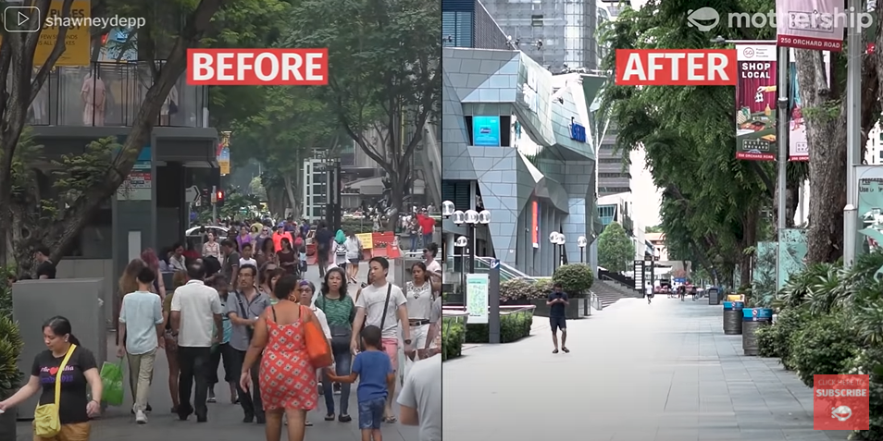
Before and After Circuit Breaker
Marina Bay Area and Orchard Road
(Source:https://www.straitstimes.com/multimedia/photos/in-pictures-singapore-before-and-after-circuit-breaker-mode-imposed)

Slide 5
How should the government help to recover the economy?

Slide 6
OUR PROJECT PROCESS
Find Data Source
Use Models to make Prediction
Compute and Compare results
Conclusion and Recommendation

Slide 7
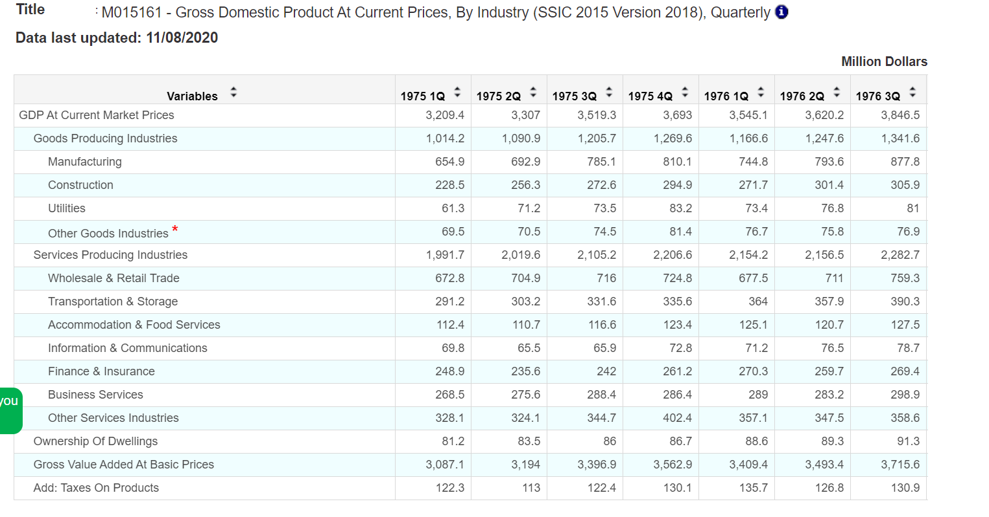
DATA SOURCE
Singapore Department of Statistics (DOS)
https://www.singstat.gov.sg/

Slide 8
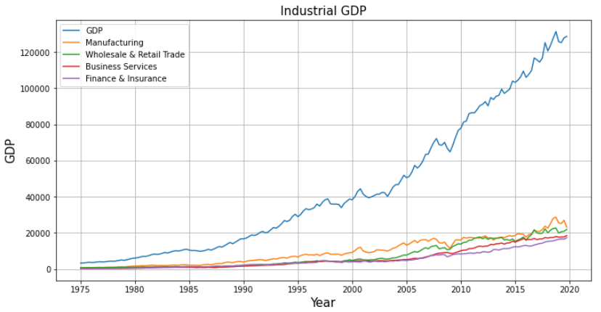

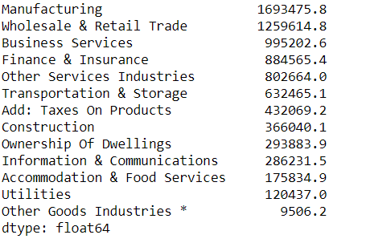
RANK & EXTRACT TOP 4 INDUSTRIES
Top 4 Industry Sectors

Slide 9
What Models
to use?

Slide 10
TIME SERIES MODELS
VAR
Vector autoregression
a statistical model used to capture the relationship between multiple quantities as they change over time.
a type of stochastic process model.
generalize the single-variable (univariate) autoregressive model by allowing for multivariate time series
ARIMA
Autoregressive Integrated Moving Average
a class of models that 'explains' a given time series based on its own past values (lags and lagged forecast errors) to forecast future values

Slide 11
Now,
Let’s get
into details...

Slide 12
VAR MODEL

Slide 13
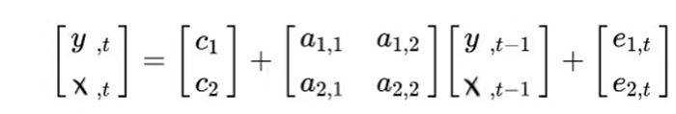
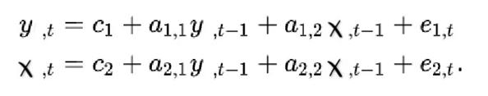
INTRODUCTION OF VAR MODEL
Formula:
VAR(1) of two variables in matrix form:
VAR(1) of two variables in equation form:
α is the intercept.
β1, β2 till βp are the coefficients of the delayed value.
ε_{t} is the error, which is considered as white noise.

Slide 14
REQUIREMENT OF VAR MODEL
The basic requirements to use VAR are:
At least two stationary time series (variables).
The time series should influence each other.

Slide 15
What are the
procedures
to build VAR model
in Python?

Slide 16
PROCEDURES OF VAR MODEL
Procedures:
Analyze the time series characteristics
Test for stationarity
Make the data stationary through log and differencing, if needed
Test for causation amongst the time series
Test for cointegration
Find optimal order (p) of VAR model
Prepare training and test datasets
Train the model
Test the model
Roll back the transformations, if any.
Evaluate the model using test set
Forecast to future

Slide 17
How do we
perform our
analysis?

Slide 18
DATA PROCESSING
Initial Data Preparation and Tests:
No | Purpose | How we do
1 | To stabilize the variance of the time series | Logarithmize
2 | To eliminate the influence of seasonal factors | Data decomposition
3 | To test the stationarity of the time series | ADF test
4 | To make our time series stationary | First differencing
5 | To test whether one time series is useful in forecasting another | Granger Causality Test
6 | To test the cointegration relationship | Johansen test

Slide 19
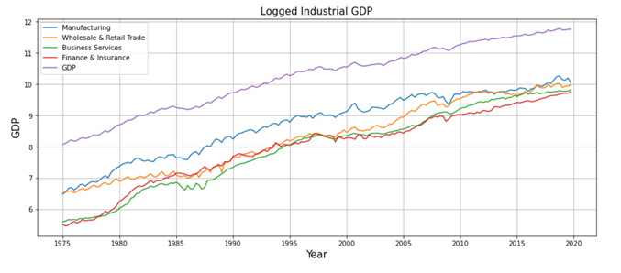
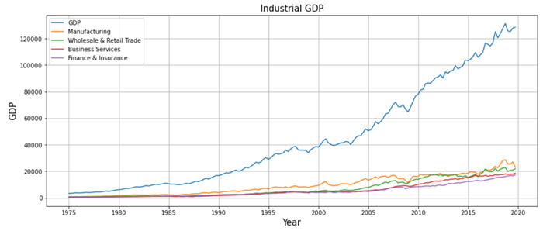
DATA PROCESSING: LOGARITHMIZATION
Logarithmization:
Stabilize the variance of a series
Return

Slide 20
DATA PROCESSING: DECOMPOSITION OF TREND
Introduction of Decomposition:
Reason of Decomposition:
Time series decomposition involves thinking of a series as a combination of the following components :
Level
Trend
Seasonality, and
Noise.
For the purpose of this project, we are only focusing on the GDP trend and yearly percentage change, therefore, Decomposition helps us to get rid of the influnce of seasonality and noise.

Slide 21
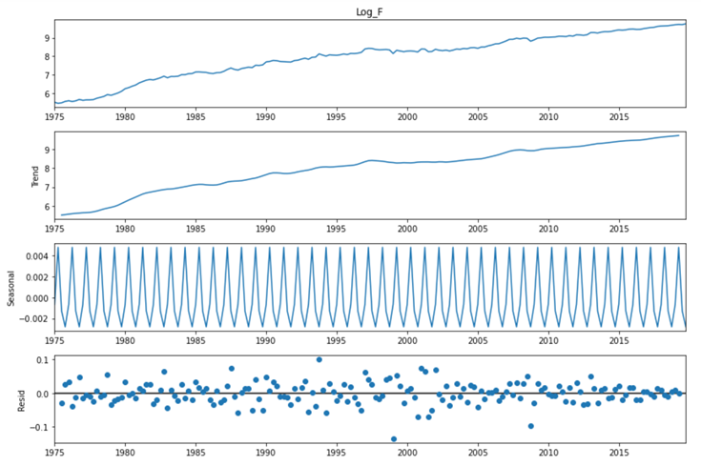
DATA PROCESSING: DECOMPOSITION OF TREND
Example of Trend Decomposition (Finance & Insurance Sector)
Extract the trend for model training and analysis
Return

Slide 22
DATA PROCESSING: ADF STATIONARITY TEST
Introduction of stationarity test:
An augmented version of the original Dickey-Fuller test
Null Hypothesis: a unit root is present in a time series
The DF unit root test is valid only when the sequence is AR(1).
If the sequence has a high-lag correlation, it can be checked by ADF.

Slide 23
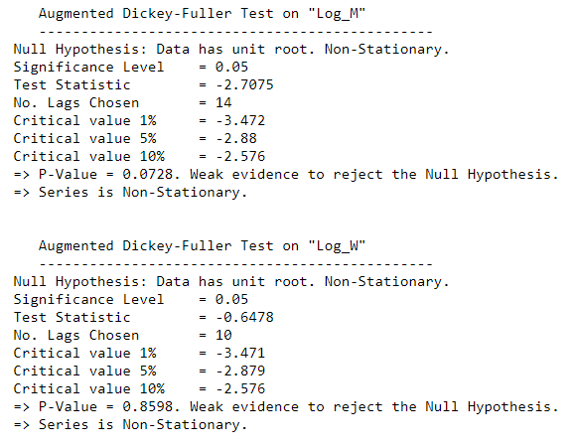
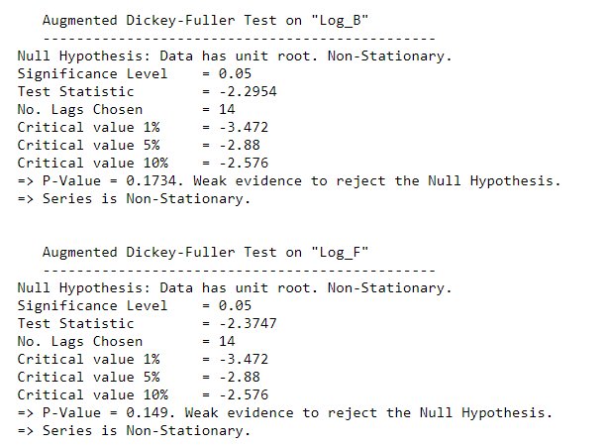
DATA PROCESSING: ADF STATIONARITY TEST
ADF test results for logged GDP trend:
Return

Slide 24
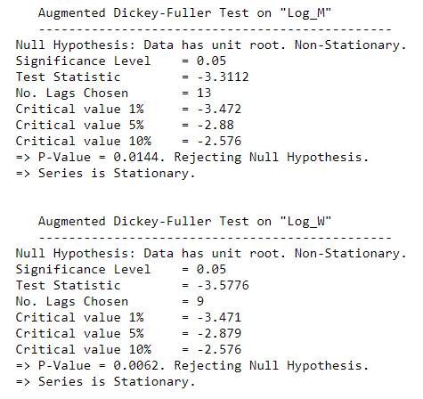
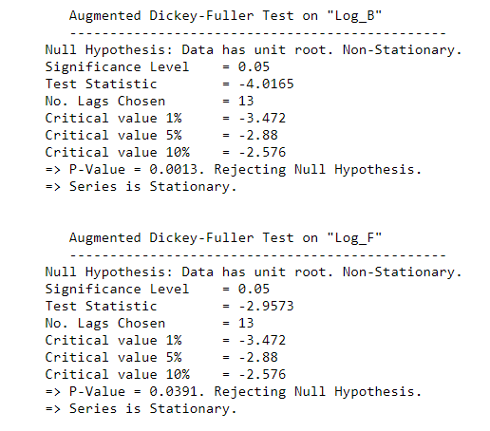
DATA PROCESSING: ADF STATIONARITY TEST
ADF test results for logged GDP trend AFTER THE 1ST DIFFERENCING:
Return

Slide 25
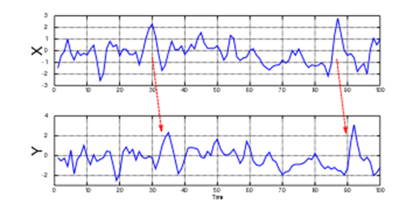
DATA PROCESSING: GRANGER CAUSALITY TEST
Introduction of Granger Causality Test
it is a statistical hypothesis test for determining whether one time series is useful in forecasting another

Slide 26
DATA PROCESSING: GRANGER CAUSALITY TEST
When time series X Granger-causes time series Y, the patterns in X are approximately repeated in Y after some time lag (two examples are indicated with arrows). Thus, past values of X can be used for the prediction of future values of Y.

Slide 27
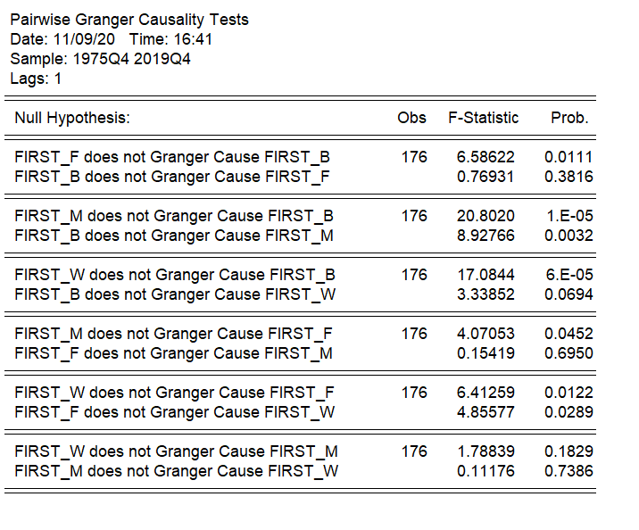

GRANGER CAUSALITY TEST

Slide 28


GRANGER CAUSALITY TEST

Slide 29
DATA PROCESSING: GRANGER CAUSALITY TEST
Summary of Granger Causality Results:
Lag | Manufacture | Wholesale & Retail Trade | Business Services | Finance & Insurance
1 | B | F、B | F、M、W | M、W
2 | F | / | F、M、W | B、M
3 | / | / | F、M、W | B、W
4 | W | M | F、M、W | B
Sample Interpretation: Service Sector’s trend are caused by Finance, Manufacturer and
Wholesales Sector at lag of 4

Slide 30
DATA PROCESSING: JOHANSEN TEST:
Introduction of Johansen Test:
It is a procedure for testing cointegration of several.
It permits more than one cointegrating relationship so is more generally applicable than the Engle–Granger test which is based on the Dickey–Fuller (or the augmented) test for unit roots in the residuals from a single (estimated) cointegrating relationship.

Slide 31
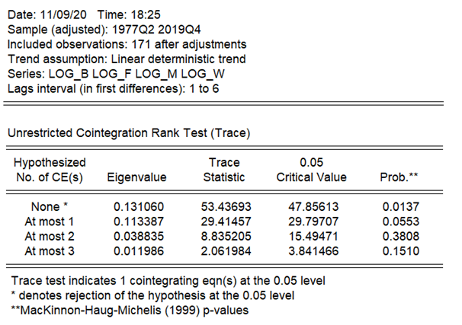
DATA PROCESSING: JOHANSEN TEST:
OUTPUT
Return

Slide 32
How to
select the
order for VAR?

Slide 33
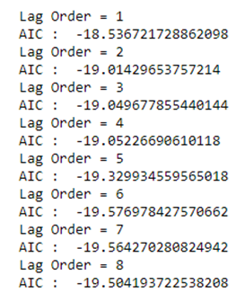
VAR MODEL: BUSINESS SERVICE SECTOR
ORDER SELECTION (P) OF VAR: AIC CRITERION
Method:
To select the right order of the VAR model, we iteratively fit increasing orders of VAR model and pick the order that gives a model with least AIC.
Conclusion:
Lag of 6 has the lowest AIC
Test Result:

Slide 34
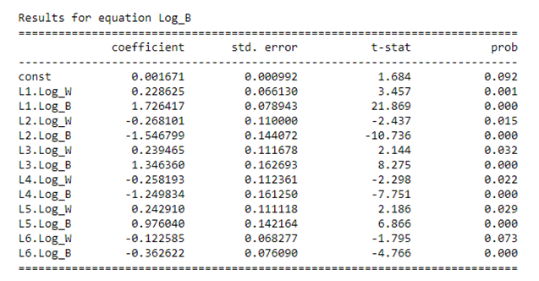
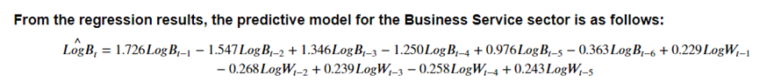
VAR MODEL: BUSINESS SERVICE SECTOR
Model Fit Summary for Business Service Sector:

Slide 35
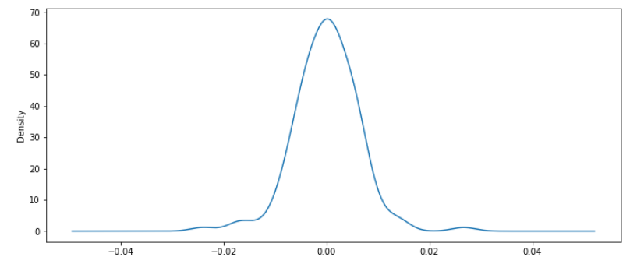
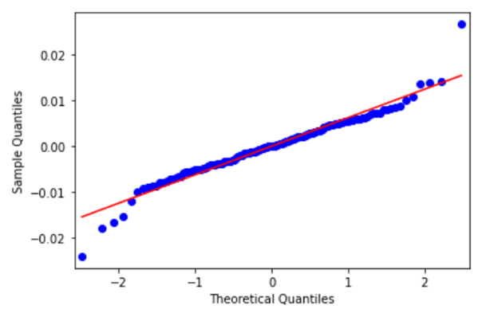
VAR MODEL: BUSINESS SERVICE SECTOR
Distribution of Model Residual Values:
Quantile-Quantile(QQ) Plot:
Conclusion: Residual is close to a normal distribution

Slide 36
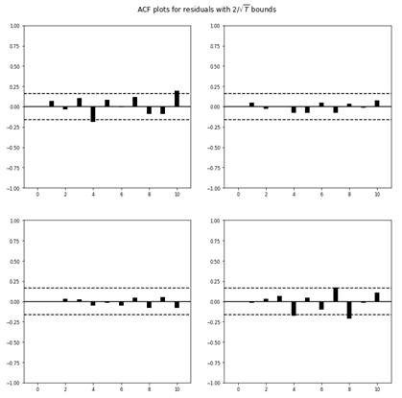
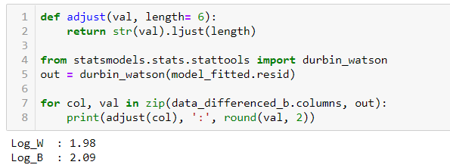
VAR MODEL: BUSINESS SERVICE SECTOR
Durbin Watson Test
ACF plot of residual values
Conclusion: There is no significant serial correlation

Slide 37
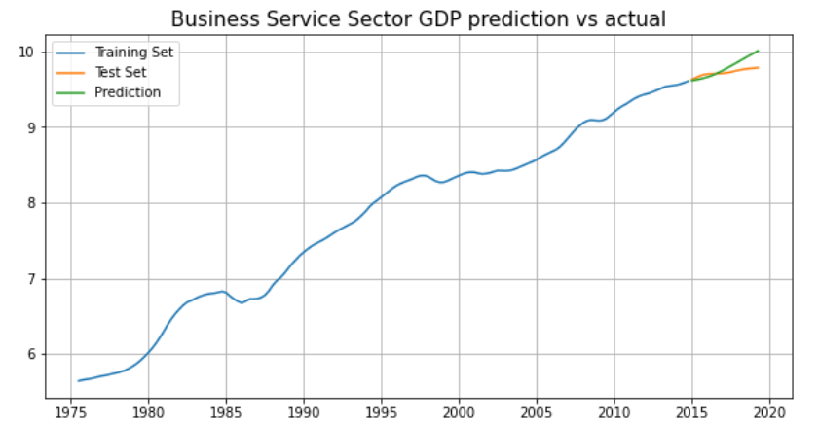
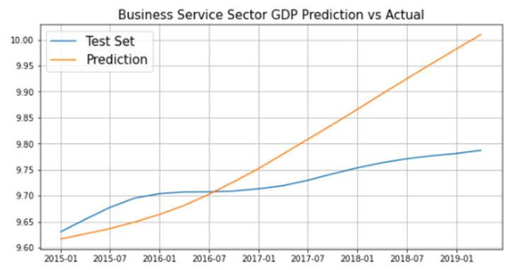
VAR MODEL: BUSINESS SERVICE SECTOR
Back Test
Training Set: 1975 to 2014
Test Set: 2015 to 2019

Slide 38
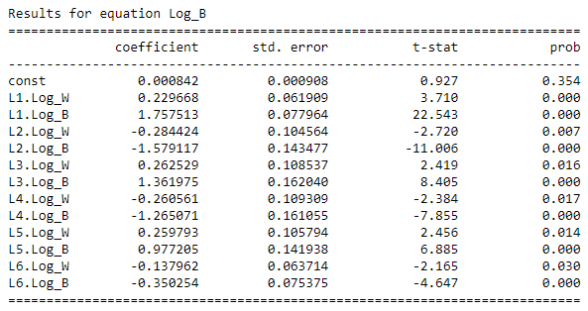
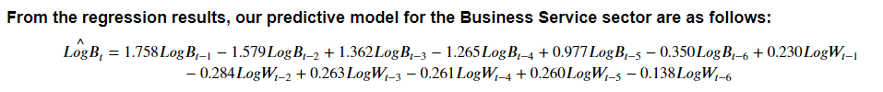
VAR MODEL: BUSINESS SERVICE SECTOR
Model Fit for Business Service Sector
Order Selected: 6
Input:
1. Wholesale, Retail and Trade Sector GDP
2. Business Service Sector GDP

Slide 39
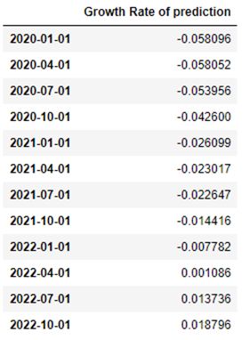
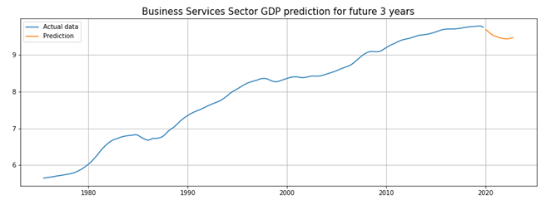
VAR MODEL: BUSINESS SERVICE SECTOR
Forecast of Business Service Sector GDP for year 2020 to 2022

Slide 40
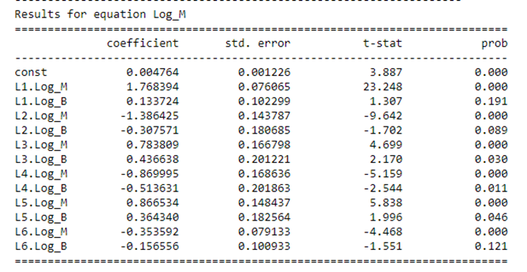
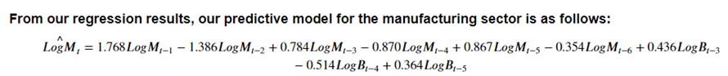
VAR MODEL: MANUFACTURER SECTOR
Model Fit for Manufacture Sector
Order Selected: 6
Input:
1. Manufacture Sector GDP
2. Business Service Sector GDP

Slide 41
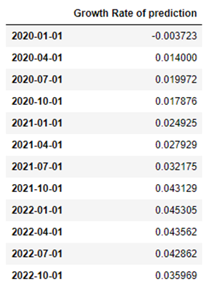
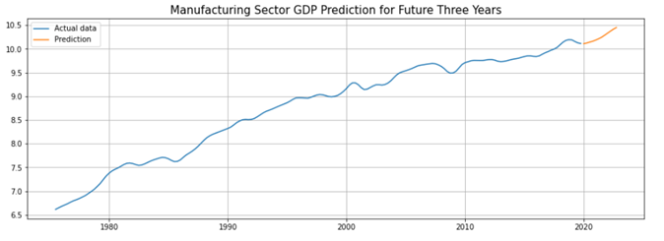
VAR MODEL: MANUFACTURER SECTOR
Forecast of Manufacturer Sector GDP for year 2020 to 2022

Slide 42
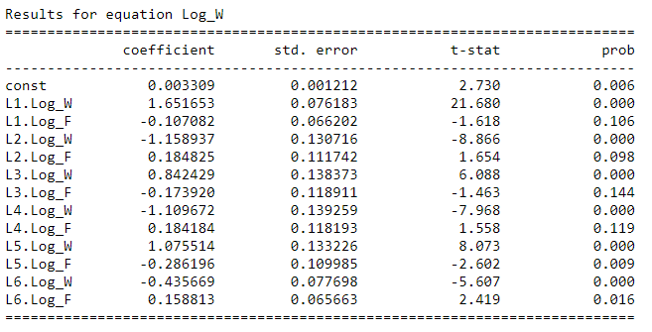
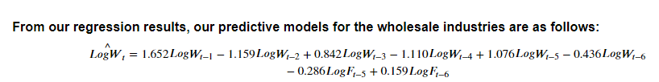
VAR MODEL: WHOLESALE AND RETAIL TRADE SECTOR
Model Fit for Wholesale and Retail Trade Sector
Order Selected: 3
Input:
1. Wholesale and Retail Trade Sector GDP
2. Finance & Insurance Sector GDP

Slide 43
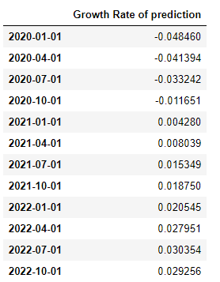
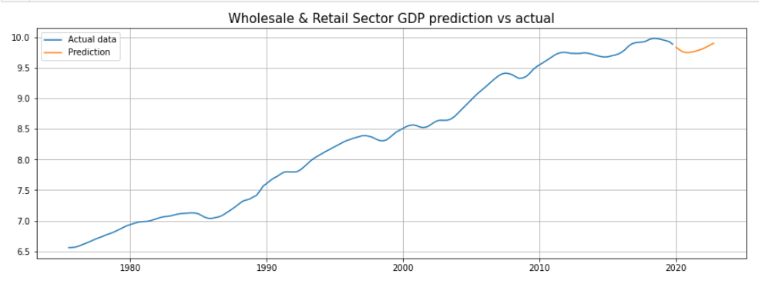
VAR MODEL: WHOLESALE AND RETAIL TRADE SECTOR
Forecast of Wholesale and Retail Trade Sector GDP for year 2020 to 2022

Slide 44
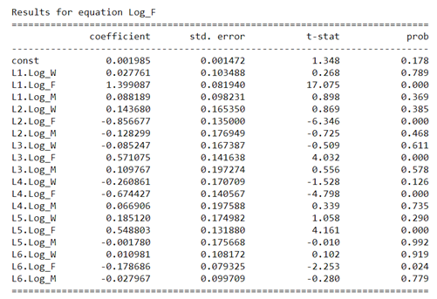
VAR MODEL: FINANCE & INSURANCE SECTOR
Model Fit for Finance and Insurance Sector
Order Selected: 6
Input:
1. Manufacture Sector GDP
2. Wholesale, Retail and Trade Sector GDP
3. Finance & Insurance Sector
Finding:
P value is too large for both Wholesale sector and Manufacture sector coefficient. Therefore suggest to use ARIMA Model for modeling instead of VAR Model

Slide 45
ARIMA MODEL

Slide 46
How to
select the
order for ARIMA?

Slide 47
ARIMA MODEL: FINANCE AND INSURANCE SECTOR
ORDER SELECTION METHOD
Model | Interpretation | Order | Method
AR | Autoregression. A model that uses the dependent relationship between an observation and some number of lagged observations | P | PACF
I | Integrated. The use of differencing of raw observations (e.g. subtracting an observation from an observation at the previous time step) in order to make the time series stationary | D | ADF
MA | Moving Average. A model that uses the dependency between an observation and a residual error from a moving average model applied to lagged observations. | Q | ACF

Slide 48
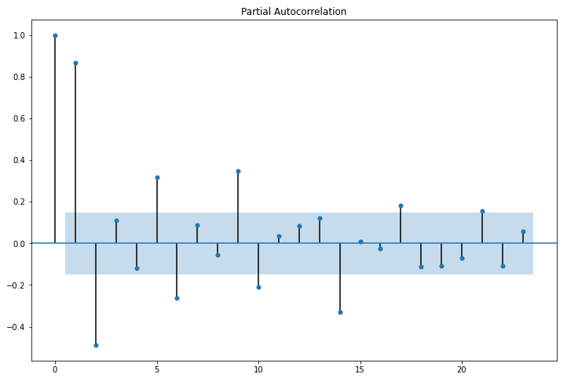
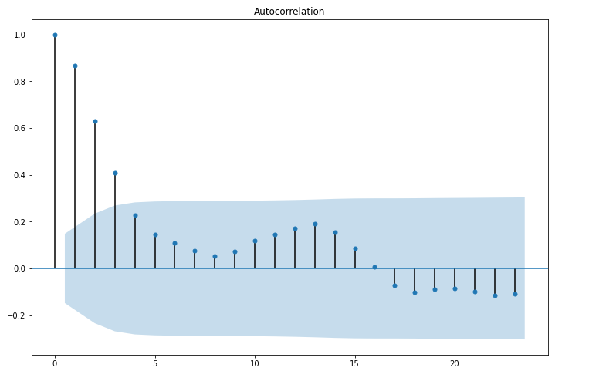
ARIMA MODEL: FINANCE AND INSURANCE SECTOR
ACF & PACF PLOT
Conclusion: Finance Sector GDP ARIMA Model Order (2, 1, 3)

Slide 49
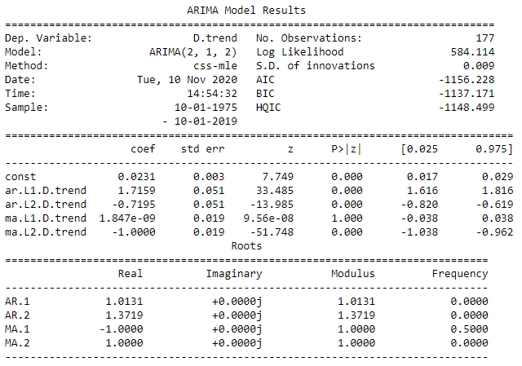
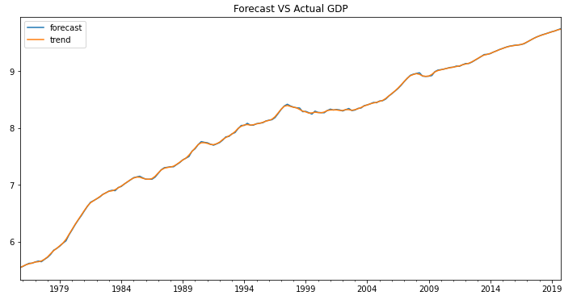
ARIMA MODEL: FINANCE AND INSURANCE SECTOR
MODEL FIT:
Best Fitted Model – Finance Sector
Training Data: | Finance Sector Quarterly GDP between 1975 to 2019
Model Order: | (2, 1, 2)
49

Slide 50
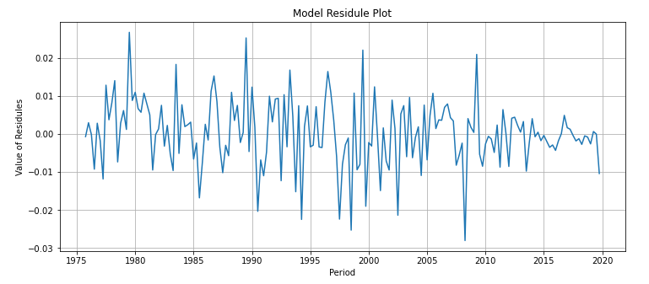
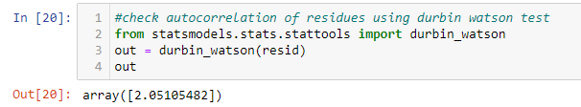
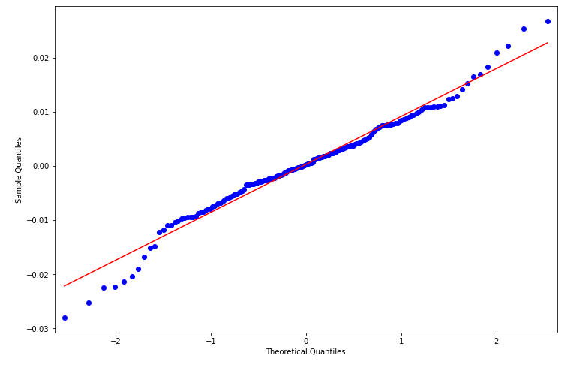
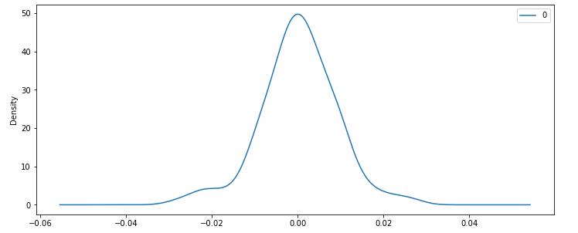
ARIMA MODEL: FINANCE AND INSURANCE SECTOR
DIAGNOSTIC TESTS:
1. Model Residual Plot
3. Durbin Watson Test:
4. Residual QQ Plot
2. Model Residual Distribution
50
50

Slide 51
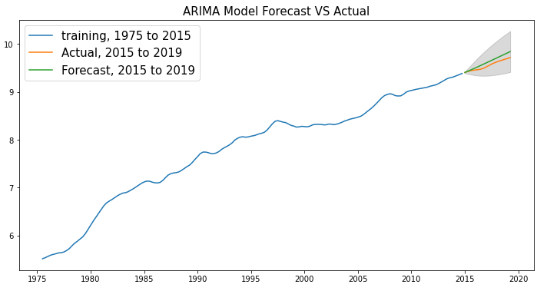
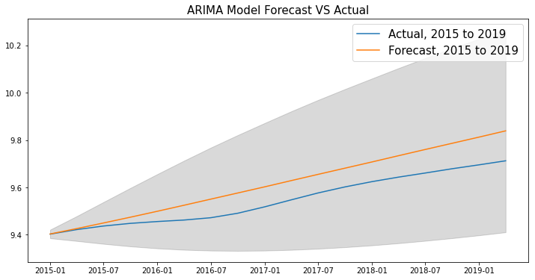
ARIMA MODEL: FINANCE AND INSURANCE SECTOR
Back Test
Training Set: 1975 to 2014
Test Set: 2015 to 2019
Conclusion: ARIMA model is reasonably accurate for short term prediction

Slide 52
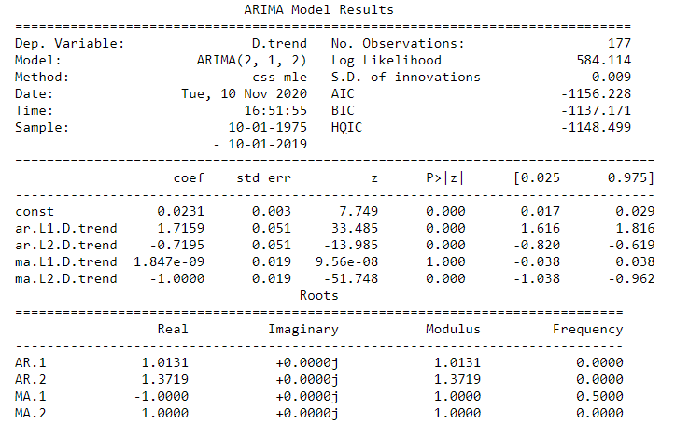
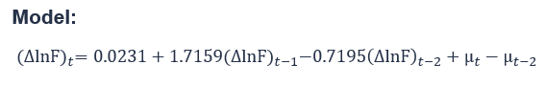
ARIMA MODEL: FINANCE AND INSURANCE SECTOR
Model Fit for Finance and Insurance Sector
Order Selected: (2, 1, 2)
Input: Finance & Insurance Sector GDP
Between 1975 to 2019

Slide 53


ARIMA MODEL: FINANCE AND INSURANCE SECTOR
Forecast of Finance and Insurance Sector GDP for year 2020 to 2022

Slide 54
Comparison Of
two Models’
results

Slide 55
Prediction VS Acrual Extropolated Sector GDP
GDP by sectors for 2020 | Model Used | Prediction (A) | Actual (B)* | EstimatedCOVID-19 Impact (A) –(B)
Manufacturing | VAR | 4.88% | -4.61% | 9.49%
Finance & Insurance | ARIMA | 4.74% | 3.30% | 1.44%
Business Services | VAR | -19.64% | -13.35% | -6.29%
Wholesale & Retail Trade | VAR | -12.84% | -17.69% | 4.84%
Remark:
* extrapolated based on 2020 Q1 & Q2 numbers.

Slide 56

PREDICTION vs ACTUAL
Most difference seen in Manufacturing and Wholesale & Retail Trade sectors
Our model is based on data from pre-Covid times (1975 – 2019)
Covid-19 has impacted the GDP adversely in 2020

Slide 57
How the Government
helps to recover Singapore’s economy
from COVID-19?

Slide 58

HELP FROM THE SG GOVERNMENT
Committed close to S$100 billion to support individuals and businesses.
Introduced many initiatives such as tax measures, employment related-measures, economic stimulus measures and sector-specific measures.
For example, for the Job Support Scheme ("JSS"), the Government has recognized some sectors are harder hit than others and are providing support accordingly.
58
(Source: https://www.mti.gov.sg/-/media/MTI/COS-2020/MTI_Budget_Booklet_for_Businesses.pdf)

Slide 59
OUR RECOMMENDATION
Recommendation:
Based on our project findings, we think that there is ample buffer for the Government to divert more resources from Finance & Insurance as well as Business Services sectors to help the other sectors which are more adversely affected by Covid-19.

Slide 60
Q & A

Slide 61
THANKS !

